Slide 1
OK Cupid Analysis
Machine Learning Fundamentals
Jason Albert
11/18/2018

Slide 2
Table of Contents
Exploration of the Dataset
Question to Answer
Augmenting the Dataset
Classification Approaches
Conclusion

Slide 3
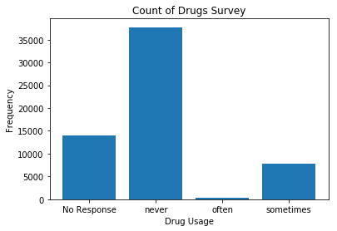
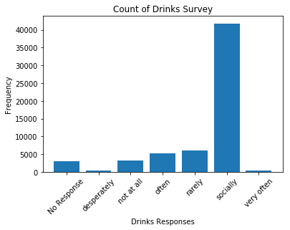
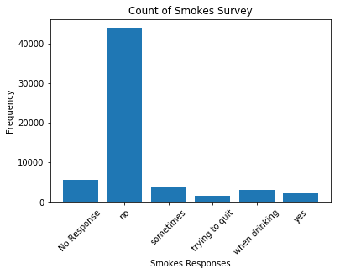
Exploration of the Dataset
What interested me in this dataset was the substance usage fields and how they might be related.
I looked at several of these fields and counted the response values using the value_counts() function. Then splitting this into x and y to plot on a bar chart with matplotlibs plt.bar() function.
These features are all very imbalanced. Most people drink only socially. Smoking is very rare and around 15% of people use drugs. One other interesting thing is that a large number of people left the drugs question blank. This could skew results.

Slide 4
Questions
After reviewing the data what really stood out was the lifestyle type features
Diet, Drinking, Smoking, Drugs, etc.
I wanted to see if we could predict if someone was a drug user based on the other social factors at play
The factors I decided on were:
Age, religion, offspring, education, job, drinks and smokes
I thought all of these could have an impact on someone doing drugs

Slide 5
Data Transformation
Nearly all of the features I chose are in text form. They needed to be encoded into integers to be used in the model.
If there were a small number of options I manually mapped them to ints with the map function
This was the case with "smokes" and "drinks"
If there is a large number of options to select from I used the label encoder function from sklearn.preprocessing. This function makes is significantly easier to encode a large number of labels at once.
For the value I was trying to predict, I transformed the "Drugs" field into a binary classification problem. Since
Original Class (smoking field) | Mapped Value
no | 0
rarely | 1
socially | 2
often | 3
Very often | 4
desperately | 5
[Nan] | 6

Slide 6
Binary Classification
Since the drugs class is so imbalanced, I wanted to consolidate the classes down into a binary problem.
First I removed the records with no response. To use this in the model I would need to make assumptions on what those nans actually mean. It would be easy for a non drug user to just respond with a "Never". But why leave blank? Could it be that they do use drugs but don't want it to be public knowledge? For now it just makes more sense to leave them out.
After that the responses "Often" and "sometimes" are transformed into 1 and "never" is transformed into 0
Index | Original Value | Mapped Value
0 | never | 0
1 | sometimes | 1
2 | often | 1

Slide 7
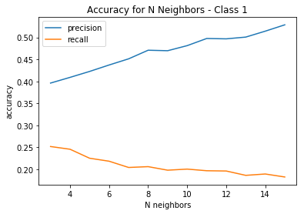
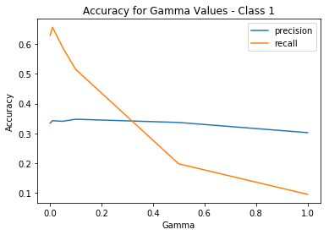
Classification Approaches
K Nearest Neighbors
Since this is an imbalanced class problem this may not be the best approach. The large number of the "0" class may overpower the "1" entries. We are really focused on accurately identifying the "Does drugs" class
K neighbors runs significantly faster than the SVC. Several seconds vs several minutes
The precision for Class 1 Continues to increase as n increases. Recall consistently drops as n increases. This model performs poorly for the features we have. Very little of the actual class 1 were identified and there are many false positives
Support Vector Machine
The SVC function has a class_weight parameter that can alter the weights to account for imbalanced class problems. Because of this reason SVC is probably the better approach for this problem.
However, the SVC takes much longer to train and run than the K nearest Neighbors. Several minutes vs several seconds on the K neighbors model
Recall peaks around 65% while precision is around 35% consistently. Only 65% of the true positives were identified and there are still >30% false positives.

Slide 8
Conclusions
Preliminary answer is that drug use cannot be predicted with the features here. Neither of the classification models have an a precision or recall high enough for me to be comfortable. The SVM has a higher accuracy but the number of false positives would make me hesitant to use this as is.
Next steps would be to try to bring the classes more into balance. Either Oversampling the minority class (1) or under sampling the majority class (0). The other thing we could do it transform the features further. Some of them, like religion, have many options. Reducing down this variability could have a positive impact. For example, We could reduce the religion field down to whether we think the religious nature would prevent someone from doing drugs.
Ie, if someone is an athiest, there would be no religious hesitancy
If someone is a christian, but not serious, this would not prevent drug usage
If someone is a christian and very serious, it would likely stop someone from using drugs
I would also want more data around drugs. Drugs could mean a pretty wide variety of things. Most people would associate this with Marijuana. But in states where it is leagalized they might not consider this drugs at all. We could break out which states have this legalized and alter the features to ask about marijuana individually. Another approach could be to take a probabilistic approach. Instead of just a binary Yes/no problem, we could estimate the probability that someone would be a drug user. No matter what features we use there would probably some overlap just due to personal preference. A probabilistic approach could account for having overlap between the classes.

